Slide 2

LINKED LIST (PART I)
IT3230E Data structure and algorithms Lab

Slide 3
Outline
Introduction to linked list
Implementation of singly linked list data structure
Using list in specific problems

Slide 4
Towards Dynamic Data Structures
Array is a collection of homogeneous elements which are stored at consecutive locations
Main limitations of arrays:
It is a static data structure
Its size must be known at compilation time, in most programming languages
Inefficient insertion and deletion of elements
A dynamic data structure can overcome these problems

Slide 5
What is a Dynamic Data Structure?
A data structure that can shrink or grow during program execution
The size of a dynamic data structure is not necessarily known at compilation time, in most programming languages
Efficient insertion and deletion of elements
The data in a dynamic data structure can be stored in non-contiguous (arbitrary) locations
Linked list is an example of a dynamic data structure

Slide 6
What is a singly linked List?
A linked list is a collection of nodes, each element (node) holding some information and a pointer to the next node in the list
In the following example, there are four nodes, which are not stored at consecutive locations
300
100
400
40
!
80
25
600
30
Information part
Pointer (Address part)

Slide 7
Outline
Introduction to linked list
Implementation of singly linked list data structure
Using list in specific problems

Slide 8
Implementation of singly linked list in C
In C, the pointer is used for the location of the next element.
the value of the last node is NULL
Using Self-Referential Structures
You may define the type for INFO data using struct and typedef
Important factor: root pointer
always points to the first element
INFO 1
INFO 2
.....
root (or head)
NULL

Slide 9
Self-Referential Structures
One or more of its components is a pointer to itself.
struct list {
char data;
struct list *link;
};
list item1, item2, item3;
item1.data=‘a’;
item2.data=‘b’;
item3.data=‘c’;
item1.link=item2.link=item3.link=NULL;
a
b
c

Slide 10
Operations for singly linked list
Memory allocation for a new element (node)
Insert new node to the list
at head
in the middle (based on position of current node or an absolute position):
after current node
before current node
Delete (remove) an element
Navigate (traverse) – Display the content - Searching
Inverse the list
Free the list
...

Slide 11
Main steps in building a program using data structures
Data types definition of the data structure
for an INFO field, for a data structure item
Global variable declaration (optional)
important pointers for example
Implementation of the useful operations on data structure as functions
Usage of data structures and functions in the program

Slide 12
Illustrative Problem: Phone contact management

Slide 13


Description
Develop a mobile phone contact management program, in which each contact includes information about full name, phone number and email.
Build a single linked list to store and manage contacts with a set of functions that allow:
Add a new element to the beginning of the list.
Add a new element after the current contact element
Display stored contacts in the list
Delete a contact: At the top of the list; In the current position,..
Reverse the list - Free up memory allocated to the list

Slide 14
Type declaration for INFO field in each node
you can organize contact elements and data structure using following record structure contact. Define by your self a structure for storing information about an contact address.
typedef struct contact_t {
char name[20];
char tel[11];
char email[25];
} contact; // contact is the type for INFO field
Notes:
hint

Slide 15
Declaration of singly linked list of contacts
struct list_el {
contact el;
struct list_el *next;
};
typedef struct list_el node;
“next” is the pointer variable which can express the next element; an element of the type node.
“el” is the instance of a contact.

Slide 16
Declaration of important pointers
root (or head) keeps the head of the list.
It is used to manage, get access to the list
cur: Pointer variable that keeps the element just now.
prev: Pointer point to the previous node of the one pointed by cur (optional)
node *root, *cur;
node *prev; /* in case you used prev */
cur
root (or head)
NULL
Notes:
Lưu ý là slide hướng dẫn cài đặt phiên bản đơn giản dùng biến toàn cục – phù hợp các chương trình dùng 1 danh sách. Còn để xây dựng CTDL dùng cho nhiều list thì nên dùng tham số trong hàm

Slide 17
Function implementation: memory allocation for a new node
node* makeNewNode(){
node* new = (node*) malloc(sizeof(node));
strcpy((new->el).name, "Tran Van Thanh");
.... // similar statement for other contact fields
new->next =NULL;
return new;
}
The function allocates memory and initializes one node but do not add it to the list
Limitation: low reusability because value of data field is assigned directly in the code

Slide 18
Function implementation: memory allocation for a new node
Improve the makeNewNode function
receive the data field as parameter - give a specific data (for the new node) ➔ allocate new node in the memory and return the pointer
higher reusability : For example, load data from a record file and create corresponding nodes
node* makeNewNode(contact ct){
node* new = (node*)malloc(sizeof(node));
new->el= ct;
new->next =NULL;
return new;
}

Slide 19
Getting input data for a node
contact readNode(){
contact tmp;
printf(“Input the full name:”);
gets(tmp.name);
...
return tmp;
}

Slide 20
Display the information of one node
Write the function displaying the data inside a give node pointed by p.
void displayNode(node* p){
/* display name, tel, email in columns */
}
These functions (read node, display node) do not belong to the data structures but necessary and depend on problem.

Slide 21
Display the information of one node - Solution
void displayNode(node* p){
if (p==NULL){printf(“NULL Pointer error.\n”); return; }
contact tmp = p->el;
printf(“%-20s\t%-15s\t%-25s%-p\n”, tmp.name, tmp.tel, tmp.email, p->next);
}
//driver main function
void main(){
contact tmp = readNode();
root = makeNewNode(tmp);
displayNode(root);
}

Slide 22
Insert a new node to the list : at head
Hint on logic:
create new_item
new->next = root;
root = new;
cur= root;
…
root
new_item
cur

Slide 23
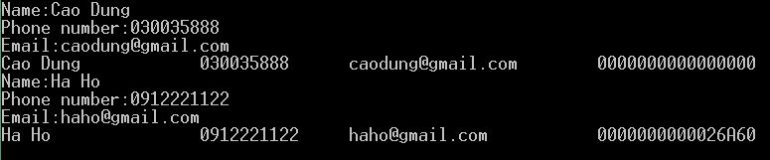
Insert node at head of the list : solution
void insertAtHead(contact ct){
node* new = makeNewNode(ct);
new->next = root;
root = new;
cur = root;
}
void main(){
contact tmp; int i;
for(i=0;i<2;i++){
tmp = readNode(); insertAtHead(tmp);
displayNode(root);
}
}

Slide 24
Insert new node after the current node
Pseudo code
create new_item
new->next = cur->next;
cur->next = new;
cur= cur->next;
cur
…
root
new_item

Slide 25
Insert new node after the current node
new = makeNewNode(ct); // ct is a contact data
if ( root == NULL ) {/* if there is no element */
root = new;
cur = root;
}
else if (cur == NULL) return;
else {
new->next=cur->next;
cur->next = new;
/* prev=cur; */
cur = cur->next;
}

Slide 26
Insert node before current position
prev
cur
root
…
Insert new item:

Slide 27
Function: insertBeforeCurrent
void insertBeforeCurrent(contact e) {
node_addr * new = makeNewNode(e);
if ( root == NULL ) { /* if there is no element */
root = new;
cur = root;
prev = NULL;
} else {
new->next=cur;
if (cur==root) {/* if cur pointed to first element */
root = new; /* nut moi them vao tro thanh dau danh sach */
}
else prev->next = new; // assume prev pointer always point to the previous node
cur = new;
}
}

Slide 28
If you do not frequently update the pointer prev
/* determine prev */
tmp = root;
while (tmp!=NULL && tmp->next!=cur && cur !=NULL)
tmp=tmp->next;
prev = tmp;

Slide 29
Insert node at the end of the list
Identify pointer p which points to the last node (next pointer is NULL)
p
root
. . . . . . .
NULL
Insert new item:

Slide 30
Insert node at the end of the list : solution
void insertAtTail(contact ct){
node* new = makeNewNode(ct);
if (root == NULL) { root = new; cur = new; prev = NULL; return;
}
node* p = root;
while (p->next !=NULL) p=p->next;
p->next = new;
cur = new; prev = p;
}
void main(){
contact tmp; int i;
for(i=0;i<2;i++){
tmp = readNode(); insertAtTail(tmp);
displayNode(root);
}
}

Slide 31
Insert node at the end of the list : version using recursion
node* insertLastRecursive(node* root, contact ct){
if(root == NULL){
return makeNewNode(ct);
}
root->next = insertLastRecursive(root->next, ct);
return root;
}
void main(){
contact tmp; int i;
for(i=0;i<2;i++){
tmp = readNode(); root = insertLastRecursive(tmp);
displayNode(root);
}
}

Slide 32
Navigate (traverse) the linked list
Necessary in tasks such as displaying list's content or copying list
The traversing is finished if the last node is reached
void traversingList(node *root){
node * p;
for ( p = root; p!= NULL; p = p->next )
displayNode(p);
}
p
root
NULL

Slide 33
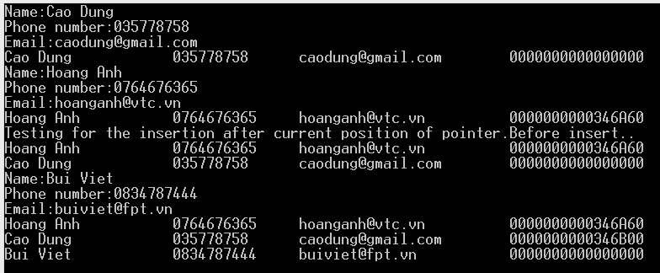
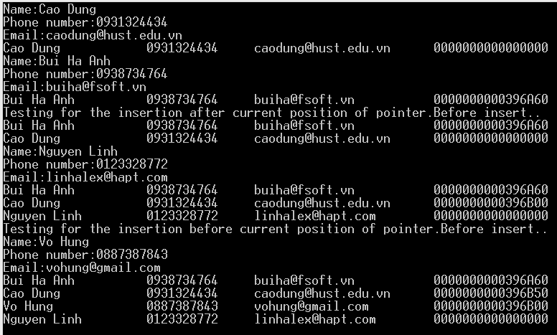
Using the functions to create and display a linked list
Using a loop to input data to Linked List then display the whole list.
void main(){
n=5;
while (n){
node tmp = readNode();
insertAtHead(tmp);
// or insertAfter..
n--;
}
traversingList(root);
}

Slide 34
Delete first element of the List
Write a function that delete the first element of the list
Logic:
del=root; root = del->next; free(del);
Change the value of “root” into the value of “next” which is pointed by “del.”
del
root
NULL

Slide 35
Delete first element of the list
void deleteFirstElement(){
node* del = root;
if (del == NULL) return;
root = del->next;
free(del);
cur = root;
prev = NULL;
}
Notes:
Bài tập 1 K59:
Đọc file Phone.dat và dùng các hàm đã viết trên lớp InsertAtHead – TraversingList để nạp dữ liệu vào danh sách và hiển thị ra màn hình.
Cài đặt lại chức năng import from DB của bài tập NokiaDB dùng danh sách móc nối. Cài đặt lại hàm in DB.

Slide 36
Delete an element from the middle
Remove the node pointed by the pointer cur (current node).
Design and implement of deleteCurrentElement function
Logic: Use pointer prev which point to the node just before the node to delete
prev->next = cur->next;
free(cur);
cur = prev->next;
prev
cur
root
Notes:
stop here

Slide 37
Solution: Delete element pointed by cur
void deleteCurrentElement(){
if (cur==NULL) return;
if (cur==root) deleteFirstElement();
else {
prev->next = cur->next;
free(cur);
cur = prev->next; // or cur = root;
}

Slide 38
Delete a node with a specific contact (using recursion)
Node* removeNodeRecursive(Node* root, contact e){
if(root == NULL) return NULL;
if(root->el == e){
Node* tmp = root; root = root->next; free(tmp);
return root;
}
root->next = removeNodeRecursive(root->next, e);
return root;
}

Slide 39
Freeing all nodes of a list
to_free
root
to_free = root ;
while (to_free != NULL)
{
root = root->next;
free(to_free);
to_free = root;
}

Slide 40
Freeing all nodes of a list
to_free = root ;
while (to_free != NULL)
{
root = root->next;
free(to_free);
to_free = root;
}
to_free
root

Slide 41
Freeing all nodes of a list
to_free
root
while (to_free != NULL)
{
root = root->next;
free(to_free);
to_free = root;
}

Slide 42
Freeing all nodes of a list
to_free
root
while (to_free != NULL)
{
root = root->next;
free(to_free);
to_free = root;
}

Slide 43
Freeing all nodes of a list
to_free
root
while (to_free != NULL)
{
root = root->next;
free(to_free);
to_free = root;
}

Slide 44
Freeing all nodes of a list
to_free
root
while (to_free != NULL)
{
root = root->next;
free(to_free);
to_free = root;
}

Slide 45
Freeing all nodes of a list
to_free
root
while (to_free != NULL)
{
root = root->next;
free(to_free);
to_free = root;
}

Slide 46
Freeing all nodes of a list
After some iteration ...
to_free
root
while (to_free != NULL)
{
root = root->next;
free(to_free);
to_free = root;
}

Slide 47
Freeing all nodes of a list
to_free
root
while (to_free != NULL)
{
root = root->next;
free(to_free);
to_free = root;
}

Slide 48
Freeing all nodes of a list
to_free
root
while (to_free != NULL)
{
root = root->next;
free(to_free);
to_free = root;
}
NULL

Slide 49
Freeing all nodes of a list
to_free
root
while (to_free != NULL)
{
root = root->next;
free(to_free);
to_free = root;
}
NULL

Slide 50
Reverse a list
Write a function that reverse the content a list.
1
2
3
root (or head)
NULL
3
2
1
root (or head)
NULL

Slide 51
Solution
node* list_reverse (node* root)
{
node *cur, *prev;
cur = prev = NULL;
while (root != NULL) {
cur = root;
root = root->next;
cur->next = prev;
prev = cur;
}
return prev;
}
1
2
3
root
NULL
1
2
3
prev = NULL
root
NULL
cur
1
2
3
prev
cur
root
NULL
1
2
3
root ==NULL
prev = NULL
prev
cur

Slide 52
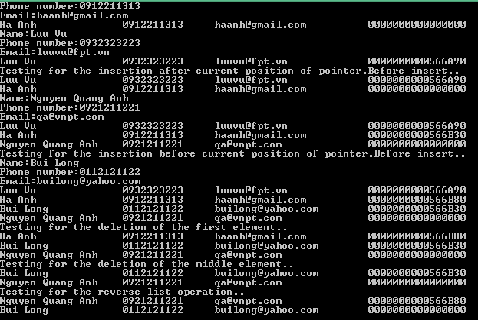
Program Output

Slide 53
Outline
Introduction to linked list
Implementation of singly linked list data structure
Using list in specific problems

Slide 54
Lab 1: Linked list manipulation
Write a program to perform the following tasks:
Build a linked list with the initially provided keys as the sequence a₁, a₂, …, a_{n}.
Perform the following operations on the list:
adding 1 element to the beginning, to the end of the list,
go before or after an element in the list,
or remove an element from the list
Submit the program on the automatic evaluation system
Notes:
Viết chương trình thực hiện công việc sau:
Xây dựng danh sách liên kết với các khóa được cung cấp ban đầu là dãy a1, a2, …, an, sau đó thực hiện các thao tác trên danh sách bao gồm: thêm 1 phần tử vào đầu, vào cuối danh sách, hoặc vào trước, vào sau 1 phần tử nào đó trong danh sách, hoặc loại bỏ 1 phần tử nào đó trong danh sách

Slide 55
Input and output format
Input
Line 1: input a positive integer n (1 <= n <= 1000)
Line 2: series of n positive integer numbers a₁, a₂, …, a_{n}.
The next lines are commands (ending with the # symbol) :
addlast k: add element with key k to the end of the list (if k does not already exist)
addfirst k: add element with key k to the beginning of the list (if k does not already exist)
addafter u v: add element with key equal to u after element with key equal to v on the list (if v already exists on the list and u does not exist yet)
addbefore u v: add the element with key equal to u before the element with key equal to v on the list (if v already exists on the list and u does not exist)
remove k: remove the element with key k from the list
reverse: reverses the order of list elements (no new elements can be allocated, only links can be changed)
Output: Displays the key sequence of the list obtained after a given sequence of operation commands

Slide 56
Example for input and output
Input
5
5 4 3 2 1
addlast 3
addlast 10
addfirst 1
addafter 10 4
remove 1
#
Output
5 4 3 2 10

Slide 57
Solution
#include <stdio.h>
#include <string.h>
typedef int elementtype;
struct node_t{
elementtype element;
struct Node* next;// point to the next element of the current element
};
typedef struct node_t Node;
Node* root = NULL;
Node* cur = NULL;
Node* prev = NULL;

Slide 58
Solution
Node* makeNewNode(elementtype e){
Node* new = (Node*) malloc(sizeof(Node));
new->element=e;
new->next =NULL;
return new;
}
Node* find(Node* root, elementtype e){
Node* p;
for(p = root; p != NULL; p = p->next){
if(p->element == e) return p;
}
return NULL;
}

Slide 59
Solution
void insertAtTail(elementtype e){
Node* new = makeNewNode(e);
if (root == NULL) { root = new; cur = new; prev = NULL; return;
}
Node* p = root;
while (p->next !=NULL) p=p->next;
p->next = new;
cur = new; prev = p;
}

Slide 60
Solution
Node* insertLastRecursive(Node* root, elementtype e){
if(root == NULL){
return makeNewNode(e);
}
root->next = insertLastRecursive(root->next, e);
return root;
}
void insertAtHead(elementtype e){
Node* new = makeNewNode(e);
new->next = root;
root = new;
cur = root;
}

Slide 61
Solution
Node* removeNodeRecursive(Node* root, elementtype e){
if(root == NULL) return NULL;
if(root->element == e){
Node* tmp = root; root = root->next; free(tmp); return root;
}
root->next = removeNodeRecursive(root->next, e);
return root;
}
void freeList(){
Node* to_free=root;
while (to_free != NULL){
root = root->next; free(to_free); to_free = root;
}
}

Slide 62
Solution
Node* addBefore(Node* root, elementtype u, elementtype v){
if(root == NULL) return NULL;
if(find(root,u) != NULL) return root;// do nothing
if(root->element == v){
Node* q = makeNewNode(u);
q->next = root; return q;
}
root->next = addBefore(root->next,u,v);
return root;
}

Slide 63
Solution
Node* addAfter(Node* root, elementtype u, elementtype v){
if(root == NULL) return NULL;
if(root->element == v){
Node* q = makeNewNode(u);
q->next = root->next;
root->next = q; return root;
}
root->next = addAfter(root->next,u,v);
return root;
}

Slide 64
Solution
Node* reverse(Node *root){
Node* p = root;
Node* pp = NULL;
Node* np = NULL;
while(p != NULL){
np = p->next;
p->next = pp;
pp = p;
p = np;
}
return pp;
}

Slide 65
Solution
void traverseList(Node* root){
Node* p = root;
while(p != NULL){
printf("%d ",p->element);
p = p->next;
}
printf("\n");
}
int main(){
solve(); traverseList(root); freeList();
}

Slide 66
Solution
void solve(){
int n, i;
scanf("%d",&n);
for(i = 1; i <= n; i++){
int k;
scanf("%d",&k);
h = insertLastRecursive(h,k);
}
while(1){
char cmd[256];
scanf("%s",cmd);
if(strcmp(cmd,"#") == 0) break;

Slide 67
Solution
if(strcmp(cmd,"addlast") == 0){
int k; scanf("%d",&k);
if(find(root,k) == NULL)//h = insertLastRecursive(h,k);
insertAtTail(k);
}else if(strcmp(cmd,"addfirst") == 0){
int k; scanf("%d",&k);
if(find(root,k) == NULL) insertAtHead(k);
}else if(strcmp(cmd,"addafter") == 0){
int u, v; scanf("%d%d",&u,&v);
if(find(root,u) == NULL)
root = addAfter(root,u,v);
}

Slide 68
Solution
else if(strcmp(cmd,"addbefore") == 0){
int u, v; scanf("%d%d",&u,&v);
if(find(root,u) == NULL) root = addBefore(root,u,v);
}else if(strcmp(cmd,"remove") == 0){
int k; scanf("%d",&k);
root = removeNodeRecursive(root,k);
}else if(strcmp(cmd,"reverse") == 0){
root = reverse(root);
}
}

Slide 69
Polynomial manipulation
A polynomial p(x) is the expression in variable x which is in the form a_{n}x^{n} + a_{n-1}x^{n-1} + …. + a₁x+ a_{0,}
where a_{i} fall in the category of real numbers
n is non negative integer, which is called the degree of polynomial.
Some basic operations in Polynomial manipulation
Polynomial creation (representation)
Addition (subtraction) of polynomials
Multiplication of polynomials

Slide 70
Polynomial representation using arrays
Coefficients are stored in the elements in an array at corresponding subscript (index)
Indexes represent exponents
Limitation: waste lot of memory spaces for sparse polynomials.
P(x) =
a₁
a₂
.....
a_{n}
a₀
8x³ + 3x² + 2x + 6
6
2
3
8
6
2
3
0
.....
0
8
8x¹⁰⁰ + 3x² + 2x + 6

Slide 71
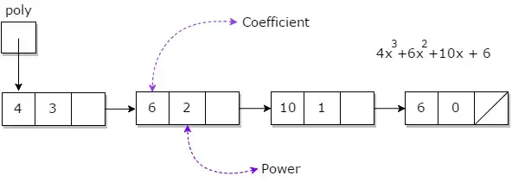
Polynomial representation using linked list
Each term is stored in a node of the list with 2 fields: coefficient and exponent
Nodes are always sorted in a decreasing order of exponents
No two nodes have the same value of exponents
Save spaces for every polynomials

Slide 72
Lab2: Polynomial manipulation
Write a program providing a list of commands over polynomials below, knowing that Each polynomial has an identifier which is a positive integer from 1 to 10000:
Create <poly_id>: create a polynomial with identifier <pol_id> if this polynomial does not exists, otherwise, do nothing
AddTerm <poly_id> <coef> <exp>: Add a term with coefficient <coef> and exponent <exp> to the polynomial having identifier <poly_id> (create a new polynomial if it does not exist)
EvaluatePoly <poly_id> <variable_value>: Evaluate and print the value of the polynomial having identifier <poly_id> and <variable_value> is the value of the variable (print 0 if the polynomial does not exist)
AddPoly <poly_id1> <poly_id2> <result_poly_id>: Perform the addition operation over two polynomials <pol_id1> and <poly_id2>. The resulting polynomial will have identifier <result_poly_id> (if the polynomial <result_poly_id> exists, then overrides the existing polynomial)
PrintPoly <poly_id>: print the polynomial <poly_id> (if it exists) to stdout under the form <c_1> <e_1> <c_2> <e_2> ... (sequence of pairs of (coefficient, exponent) of terms of the polynomial in a decreasing order of exponents)
Destroy <poly_id>: destroy the polynomial having identifier <poly_id>

Slide 73
Input and output format
Input: Each line contains a command described above (terminated by a line containing *)
Example:
AddTerm 1 3 2
AddTerm 1 4 0
AddTerm 1 6 2
AddTerm 2 3 2
AddTerm 2 7 5
PrintPoly 1
PrintPoly 2
AddPoly 2 1 3
PrintPoly 3
EvaluatePoly 2 1

Slide 74
Input and output format
Output: Each line contains the information printed out by the PrintPoly and EvaluatePoly above
Example:
9 2 4 0
7 5 3 2
7 5 12 2 4 0
10

Slide 75
Solution
#include <stdio.h>
#include <math.h>
#include <string.h>
#define N 10001
typedef struct TNode{
int coef;
int exp;
struct TNode* next;
}Node;
Node* P[N];// P[i] is the pointer to the first element of linked list representing the polynomial id = i

Slide 76
Solution
Node* makeNode(int c, int e){
Node* p = (Node*)malloc(sizeof(Node));
p->coef = c; p->exp = e; p->next = NULL;
return p;
}
void printPoly(Node* p){
for(Node* q = p; q!=NULL; q = q->next){
printf("%d %d ",q->coef, q->exp);
}
printf("\n");
}

Slide 77
Solution
Node* addTerm(int c, int e, Node* p){
if(p == NULL) return makeNode(c,e);
if(e > p->exp){
Node* q = makeNode(c,e);
q->next = p; return q;
}
if(e == p->exp){ p->coef += c; return p;
}
p->next = addTerm(c,e,p->next);
return p;
}
void processAddTerm(int id, int c, int e){ P[id] = addTerm(c,e,P[id]);
}

Slide 78
Solution
Node* addPoly(Node* p1, Node* p2){
Node* prs = NULL;
Node* last = prs;
// copy poly p1 to prs
for(Node* q = p1; q != NULL; q = q->next){
Node* newNode = makeNode(q->coef, q->exp);
if(prs == NULL)prs = newNode;
else last->next = newNode;
last = newNode;
}
for(Node* q = p2; q != NULL; q = q->next){
prs = addTerm(q->coef, q->exp, prs);
}
return prs;
}

Slide 79
Solution
void processAddPoly(int id1, int id2, int idrs){
P[idrs] = addPoly(P[id1], P[id2]);
}
void processEvaluatePoly(int id, int x){
long long rs = 0;
for(Node* q = P[id]; q != NULL; q = q->next){
rs = rs + q->coef* pow(x,q->exp);
}
printf("%lld",rs);
}
int main(){
char cmd[50];
for(int id = 1; id <= N-1; id++) P[id] = NULL;

Slide 80
Solution
while(1){
scanf("%s",cmd);
if(strcmp(cmd,"*")==0)break;
else if(strcmp(cmd,"AddTerm")==0){
int id, c, e; scanf("%d%d%d",&id,&c,&e);
processAddTerm(id,c,e);
}else if(strcmp(cmd,"PrintPoly")==0){
int id; scanf("%d",&id);
printPoly(P[id]);
}else if(strcmp(cmd,"AddPoly")==0){
int id1, id2, idrs; scanf("%d%d%d",&id1,&id2,&idrs);
processAddPoly(id1, id2, idrs);
}else if(strcmp(cmd,"EvaluatePoly")==0){
int id, x; scanf("%d%d",&id,&x);
processEvaluatePoly(id,x);
}
}
return 0;
}

Slide 81
THANK YOU !

